Slide 1
Inside of a PC

Slide 2
Goal of the lab
Understand hard drives
Understand a PC boot process
https://www.youtube.com/watch?v=PSnGuvylWBI
Familiar WinHex tool

Slide 3
Understanding Disk Drives

Slide 4
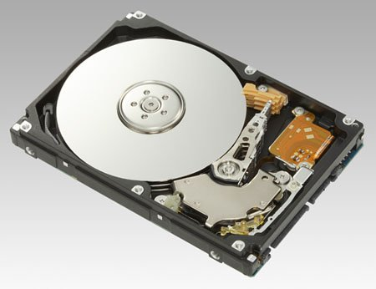
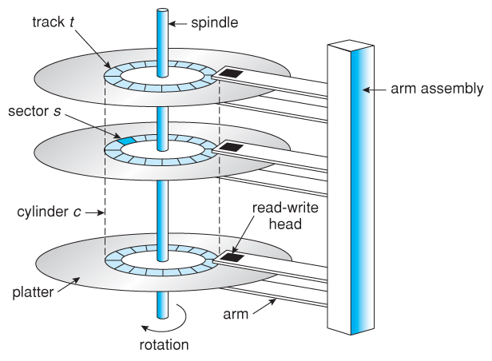
https://regmedia.co.uk/2006/12/12/fujitsu_300gb_1.jpg
Abraham Silberschatz, Greg Gagne, and Peter Baer Galvin, "Operating System Concepts, Ninth Edition "

Slide 5
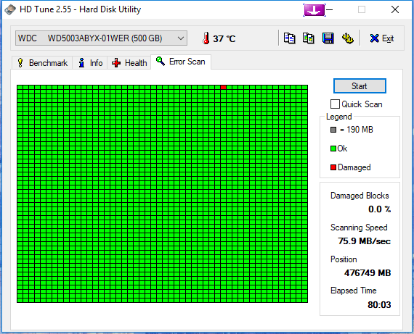
What is a disk sector
The sector is the minimum storage unit of a hard drive.
Files occupy an integral number of sectors regardless of the file's actual size.
# bytes per sector =512 Bytes
https://i.imgur.com/26BalHW.png

Slide 6
Calculate the total sectors
#sectors per track
#headers
#Cylinders (# of tracks)
Size of disk=heads x cylinder x sectors (CHS)
no of sectors: 400
no of heads: 12
cylinders: 17000
=81600000 sectors

Slide 7
Calculate the size of a disk
1024 Bytes=1K
1024 K=1M
1024 M=1G
How to compute the size of the disk in G
81600000 sectors
81600000 sectors * 512 bytes= 41779200000 bytes
=40800000 KB
=39843.75MB
=38.91G

Slide 8
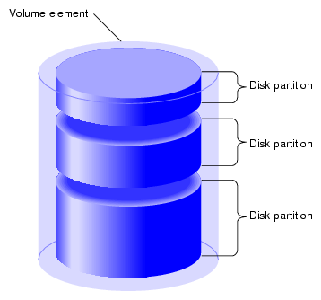
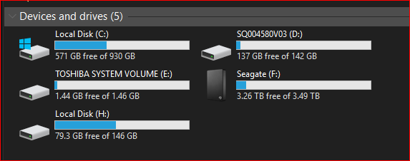
What is a partition
https://www.maketecheasier.com/assets/uploads/2012/05/partitions-partition-diagram.png

Slide 9
How does a PC load Windows Operating System?
Boot Sequence

Slide 10
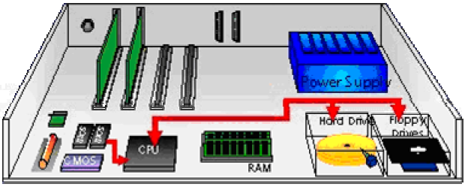
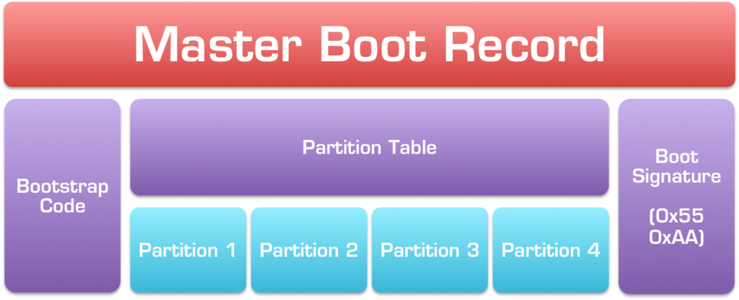
Booting a computer
Power up; computer runs power-on self-test (POST)
Boot sequence governed by (Basic input/output system) BIOS ROM
BIOS parameters stored in CMOS
Control passes to the Master Boot Record (MBR)
MBR points to boot record of selected operating system
Operating system takes control
Jump to bootable partition
http://www.c-jump.com/CIS24/Slides/Booting/Booting.html
https://i2.wp.com/neosmart.net/wiki/wp-content/uploads/sites/5/2015/01/Master-Boot-Record.png?resize=1024%2C416&ssl=1

Slide 11
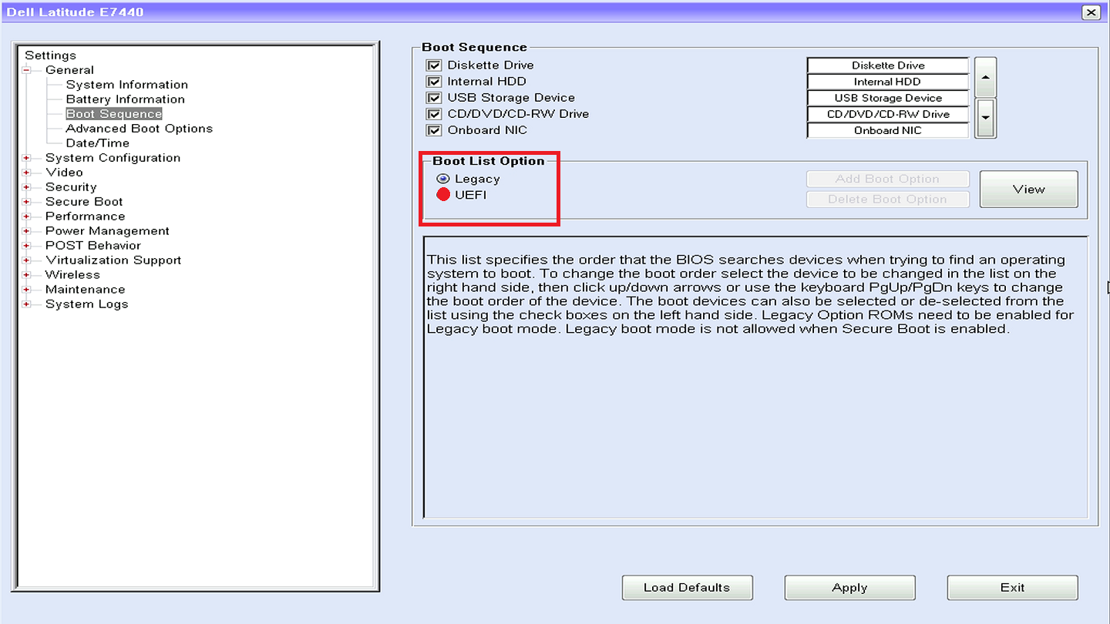

Slide 12
Find MBR

Slide 13
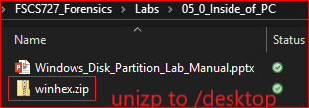
Install WinHex method 1

Slide 14
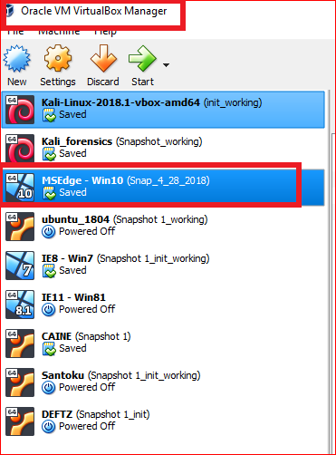
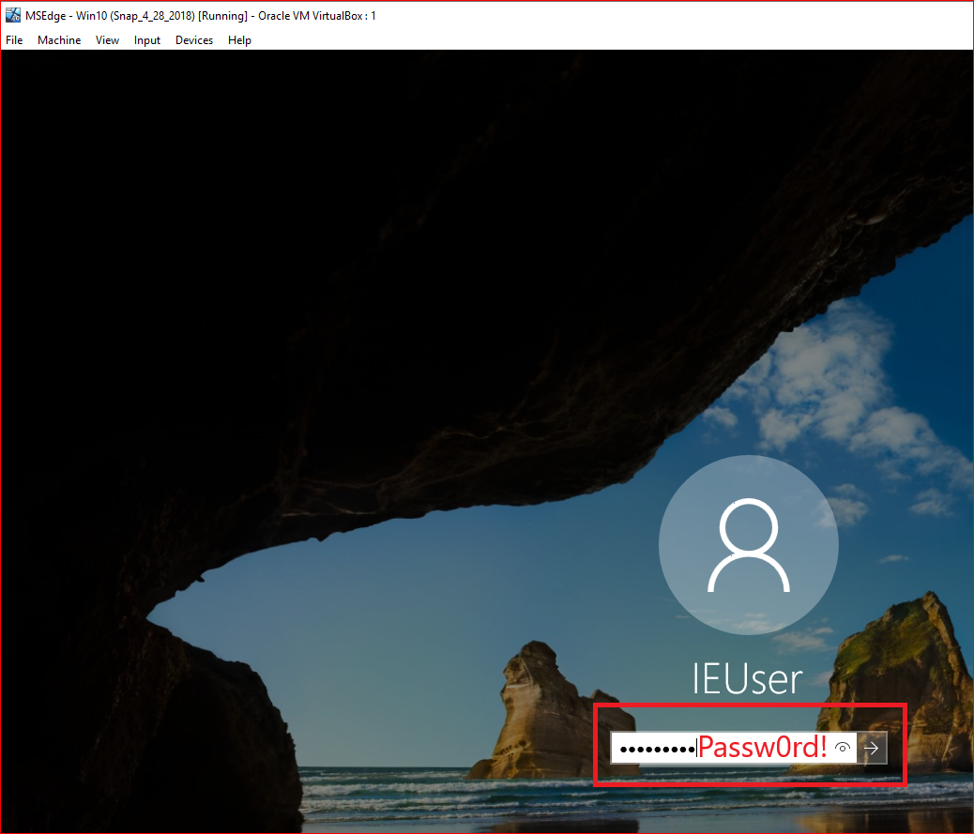
Install WinHex method 2

Slide 15
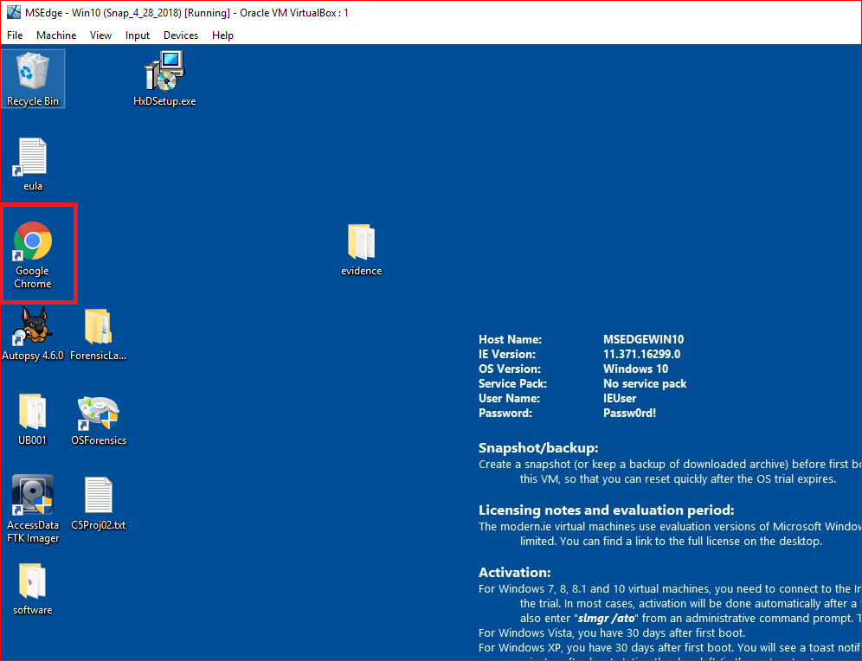

Slide 16
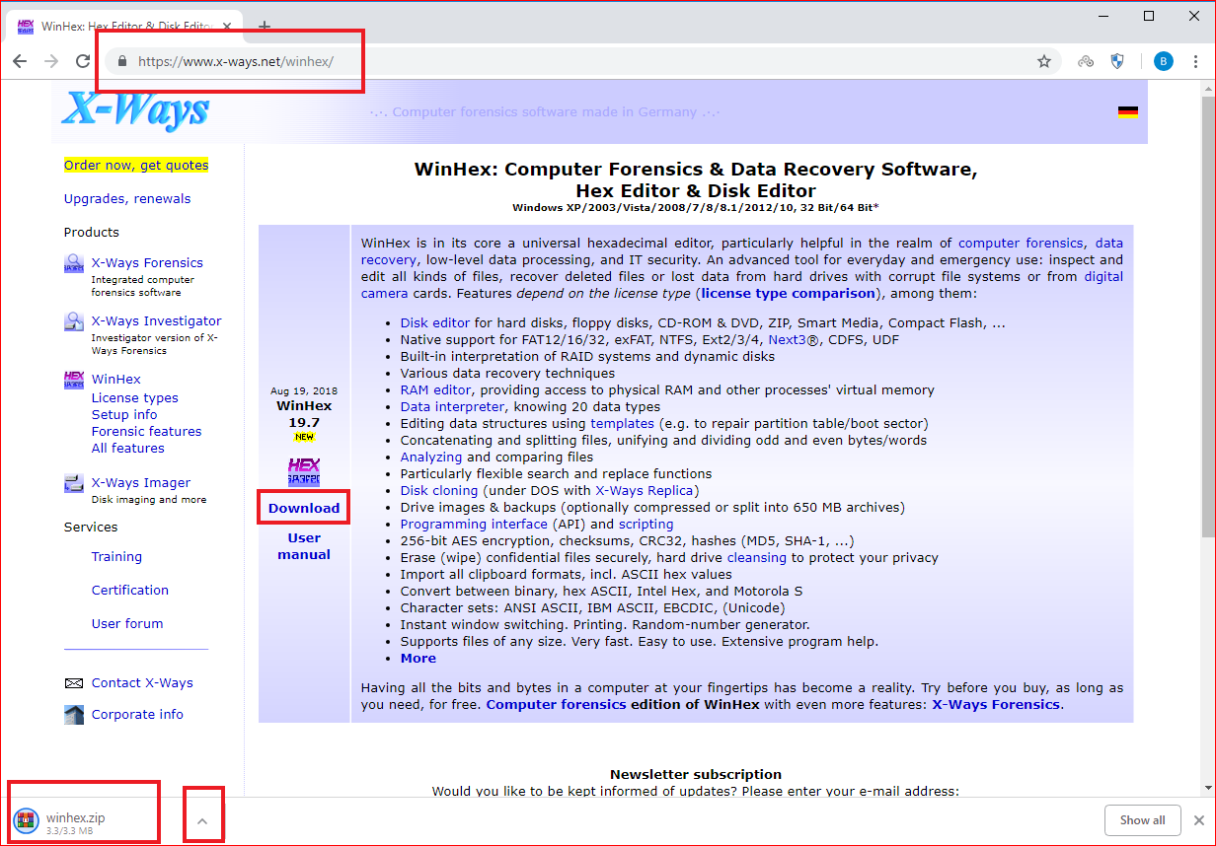

Slide 17
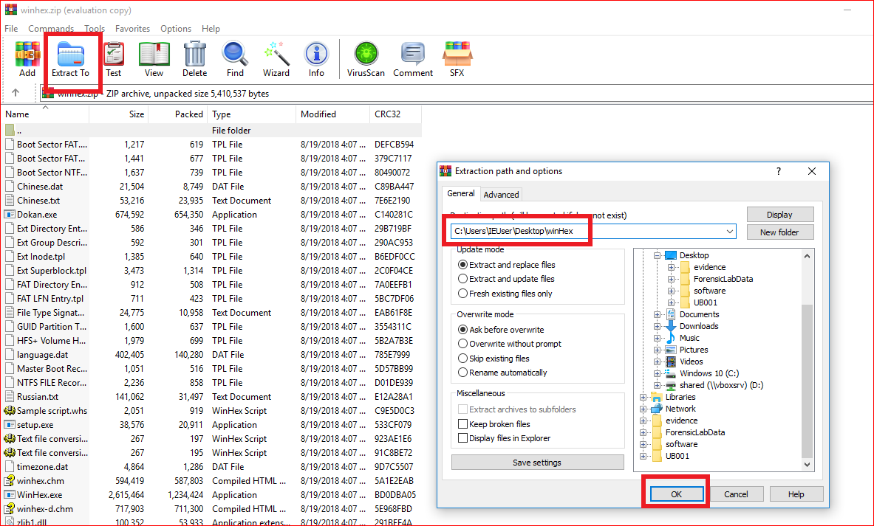

Slide 18
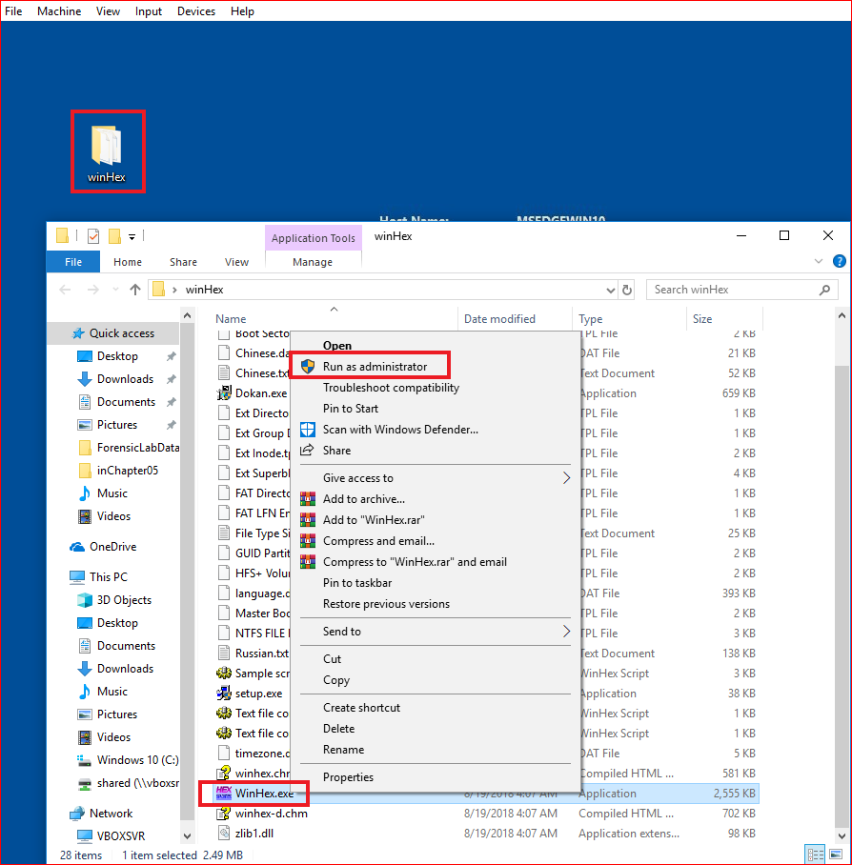
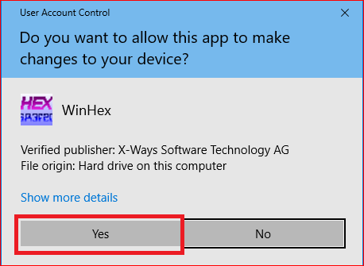
Run WinHex

Slide 19
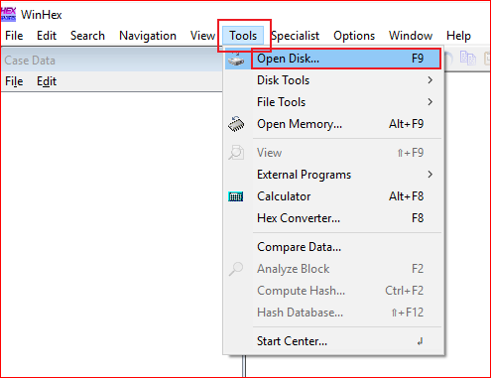
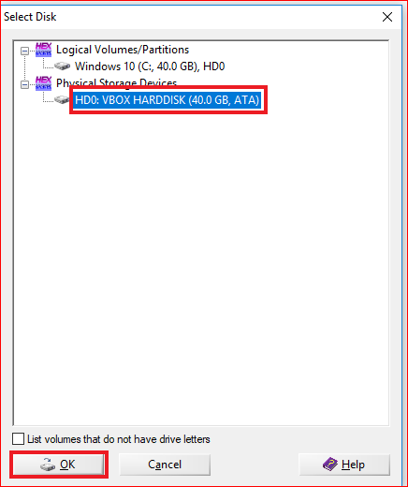

Slide 20
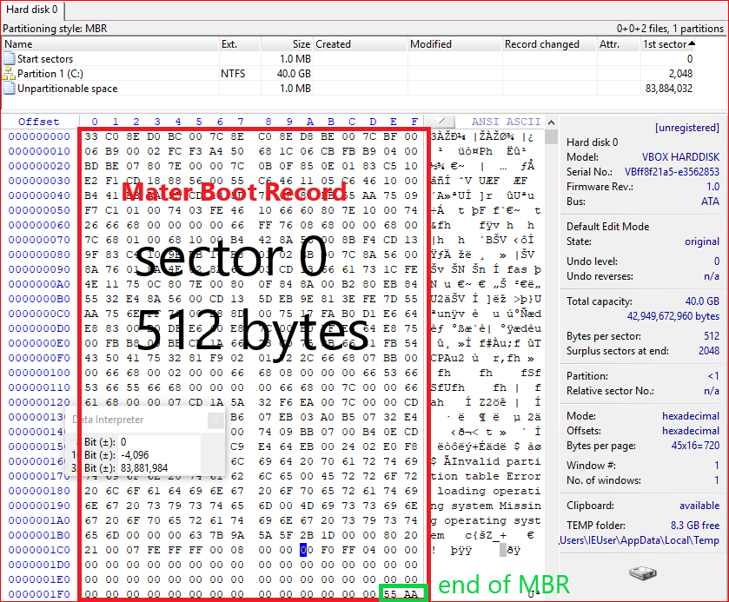

Slide 21
Calculate the size of partitions
Master Boot Record (MBR)

Slide 22
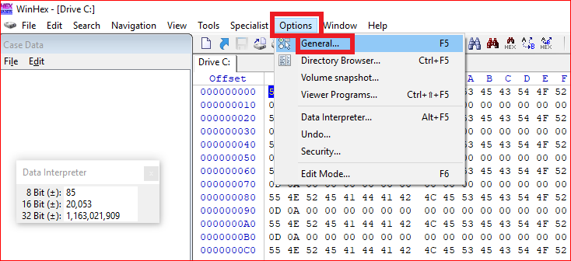
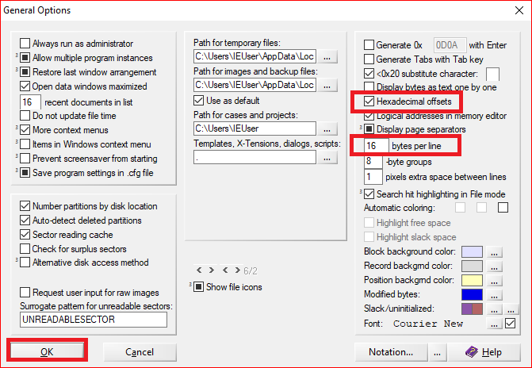

Slide 23
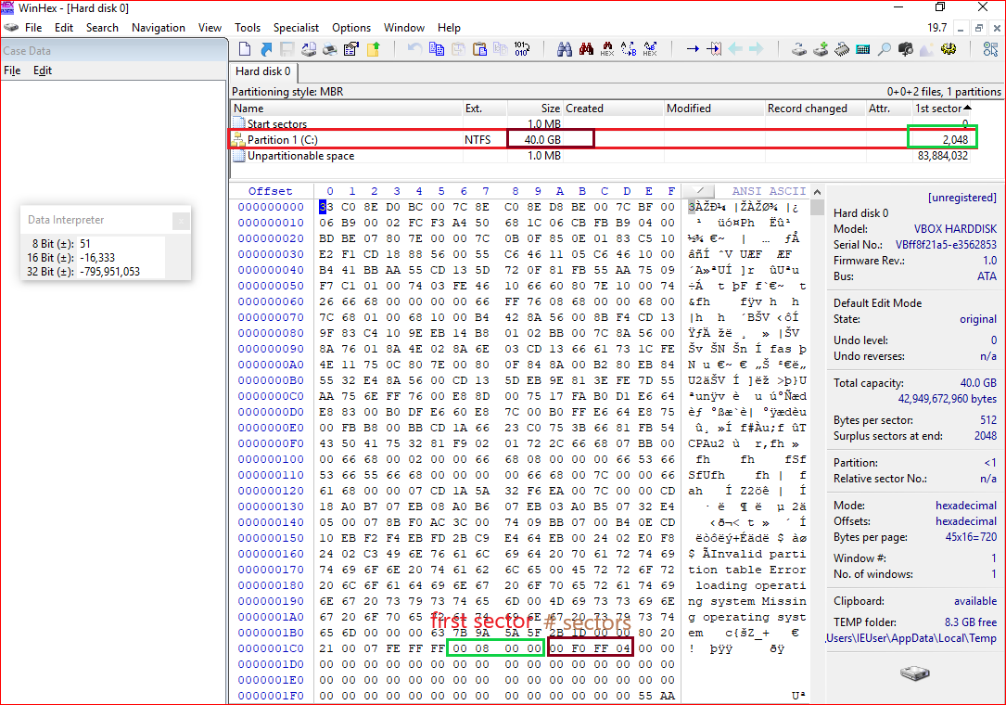

Slide 24
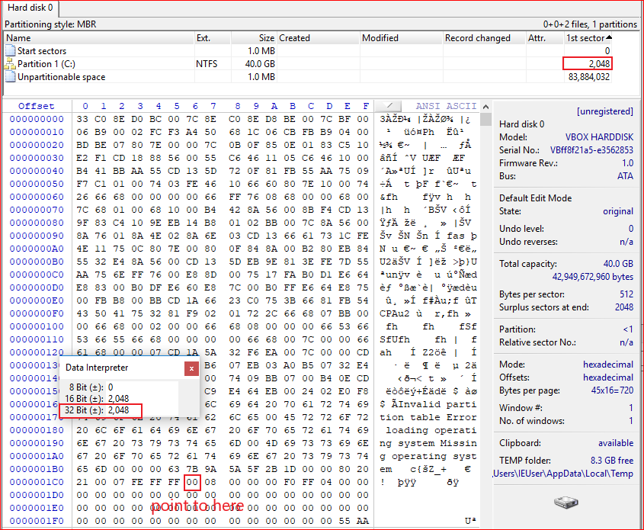

Slide 25
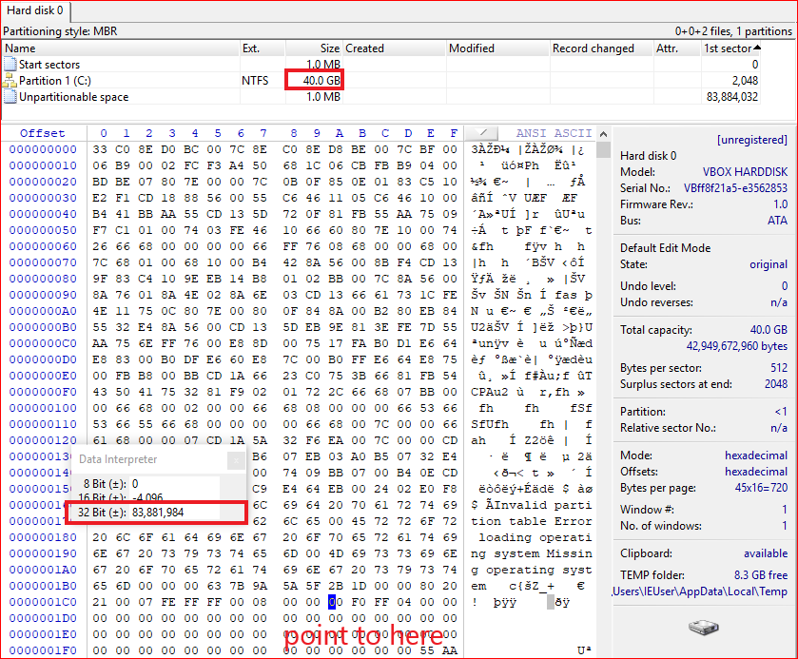
ox01CA
83881984 sectors *512 bytes per sector = 39.99 G

Slide 26
Calculate the size of partitions
Globally Unique Identifiers (GUID) Partition Table (GPT)

Slide 27
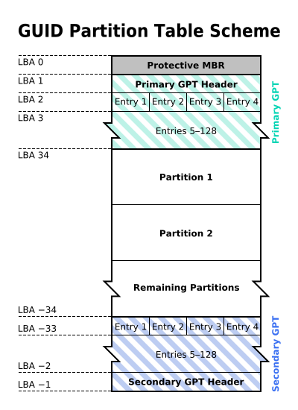
Why GPT
MBR: 1980s
Allow up to a maximum of 2 TiB
GPT: maximum size is 9.4 ZB
1ZB=1024TB
logical block addressing (LBA)
Replace CHS
By The original uploader was Kbolino at English Wikipedia. - Transferred from en.wikipedia to Commons. Transfer was stated to be made by User:Kbolino., CC BY-SA 2.5, https://commons.wikimedia.org/w/index.php?curid=3036588

Slide 28
backward compatibility for MBR
Describe each partition
Backup of the primary GPT header and entries

Slide 29
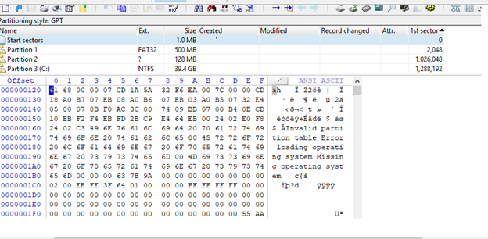
GPT example

Slide 30
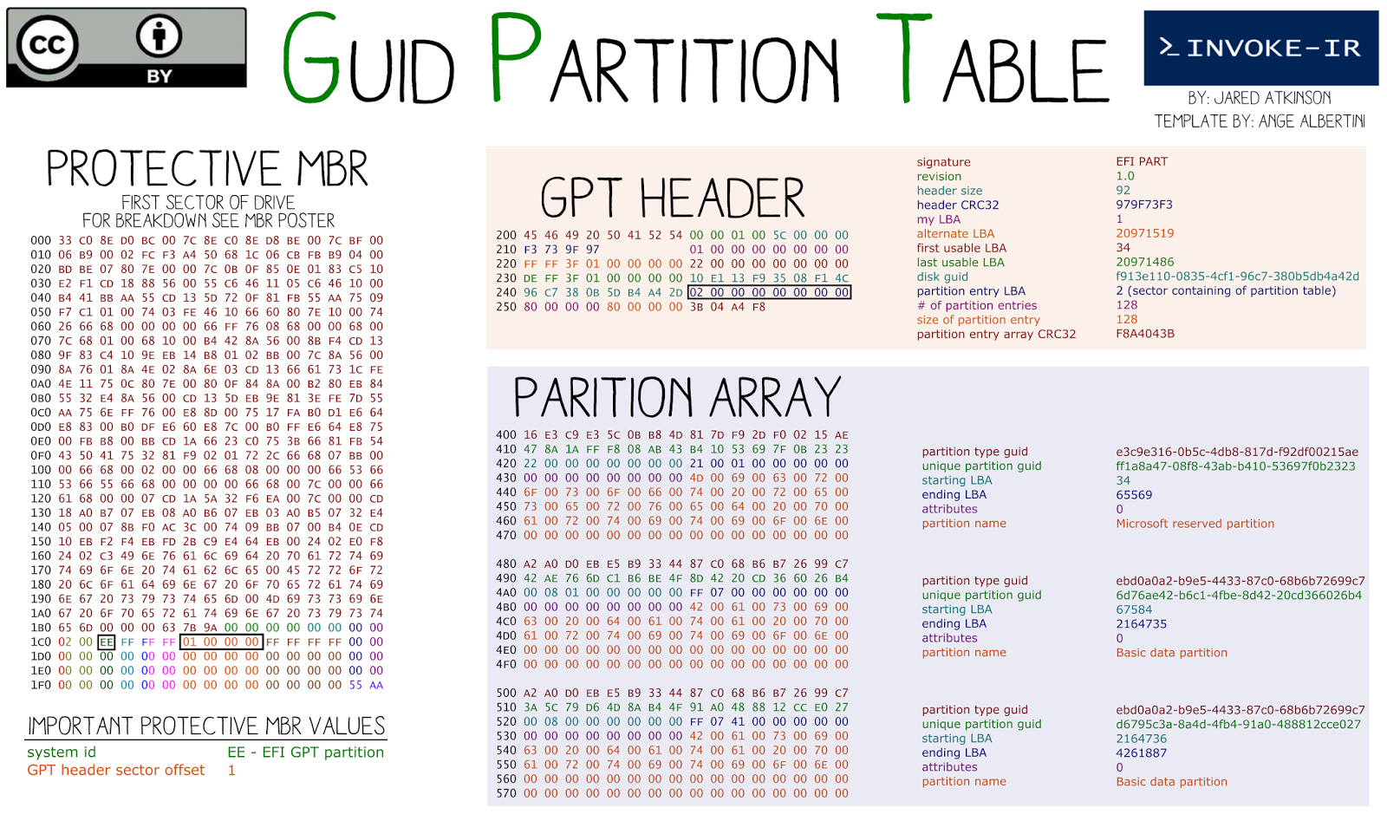
Starting LBA of array of partition entries (always 2 in primary copy)
Why 0x400?

Slide 31
Why 0x400
0x400 =1024 (2 sections)

Slide 32
Reference
Bill Nelson, Amelia Phillips, Christopher Steuart, Guide to Computer Forensics and Investigations. Sixth Edition. Cengage Learning, 2018, ISBN-13: 978-1-337-56894-4.

